Slide 1
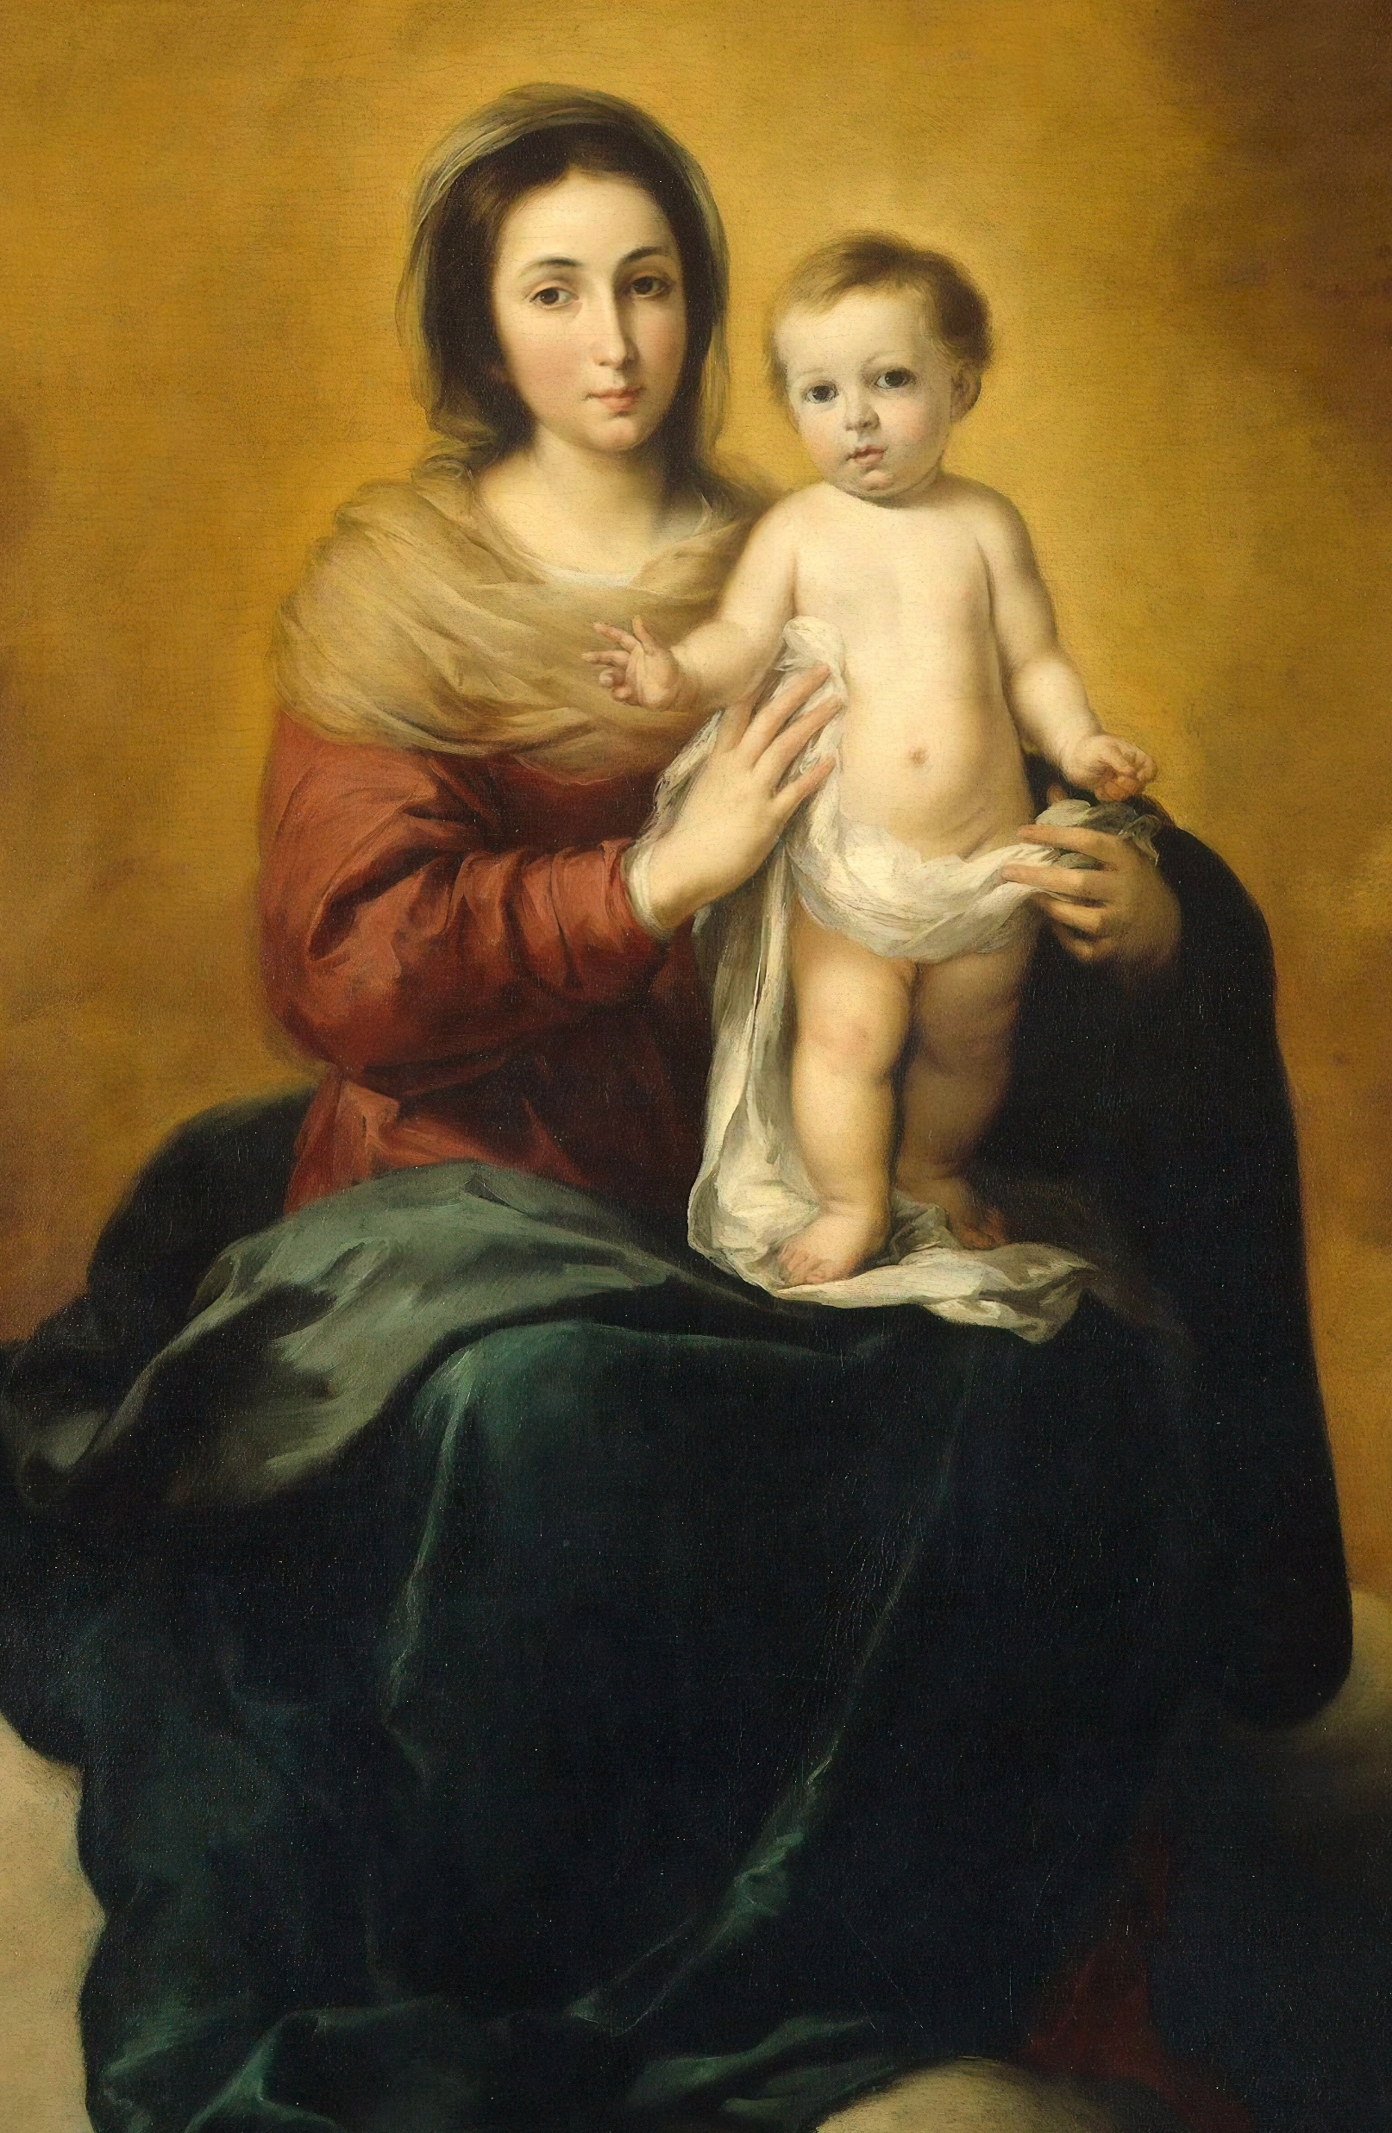
To Jesus Through Mary
Traveling Rosary Congress:
In the Diocese of Venice in Florida
October 6 - 14, 2023
[Example information]
Our Lady Queen of Martyrs Catholic Church
833 Magellan Dr.
Sarasota, FL 34243
[Schedule example]
October 9:
8AM Opening Mass
October 9:
8:30 AM Exposition w/ Rosary Every Hour
October 10:
8AM Closing Mass
Sign up for an hour at:
https:
or just show up!
For more information email Contact Name:
Contact Person Information

Slide 2
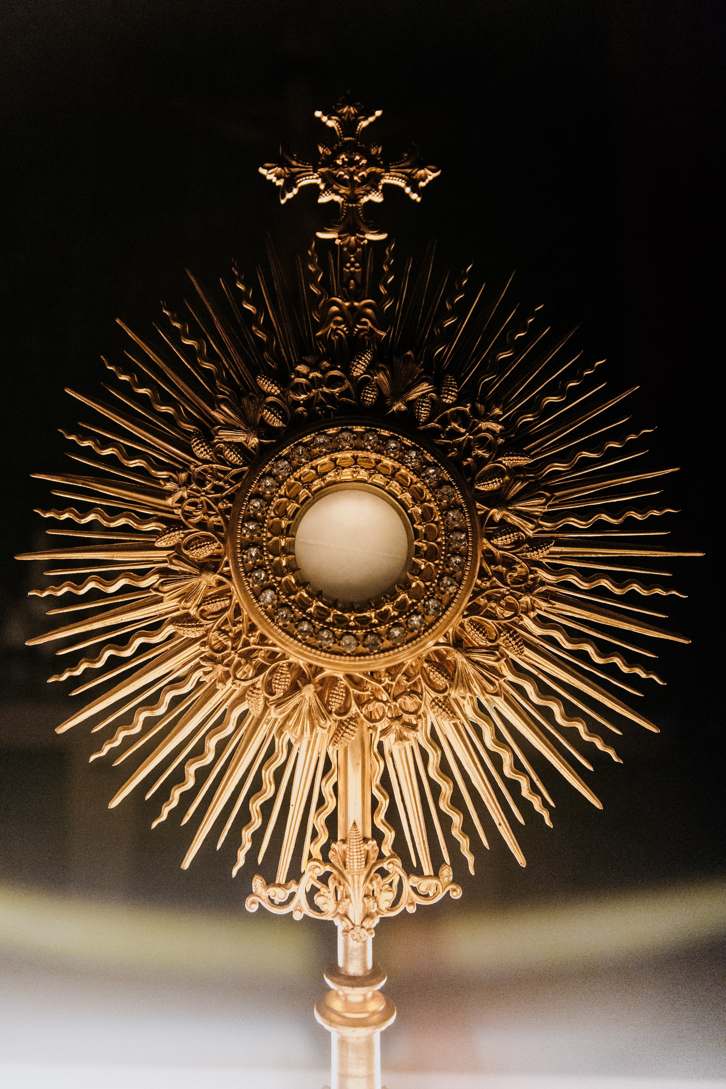
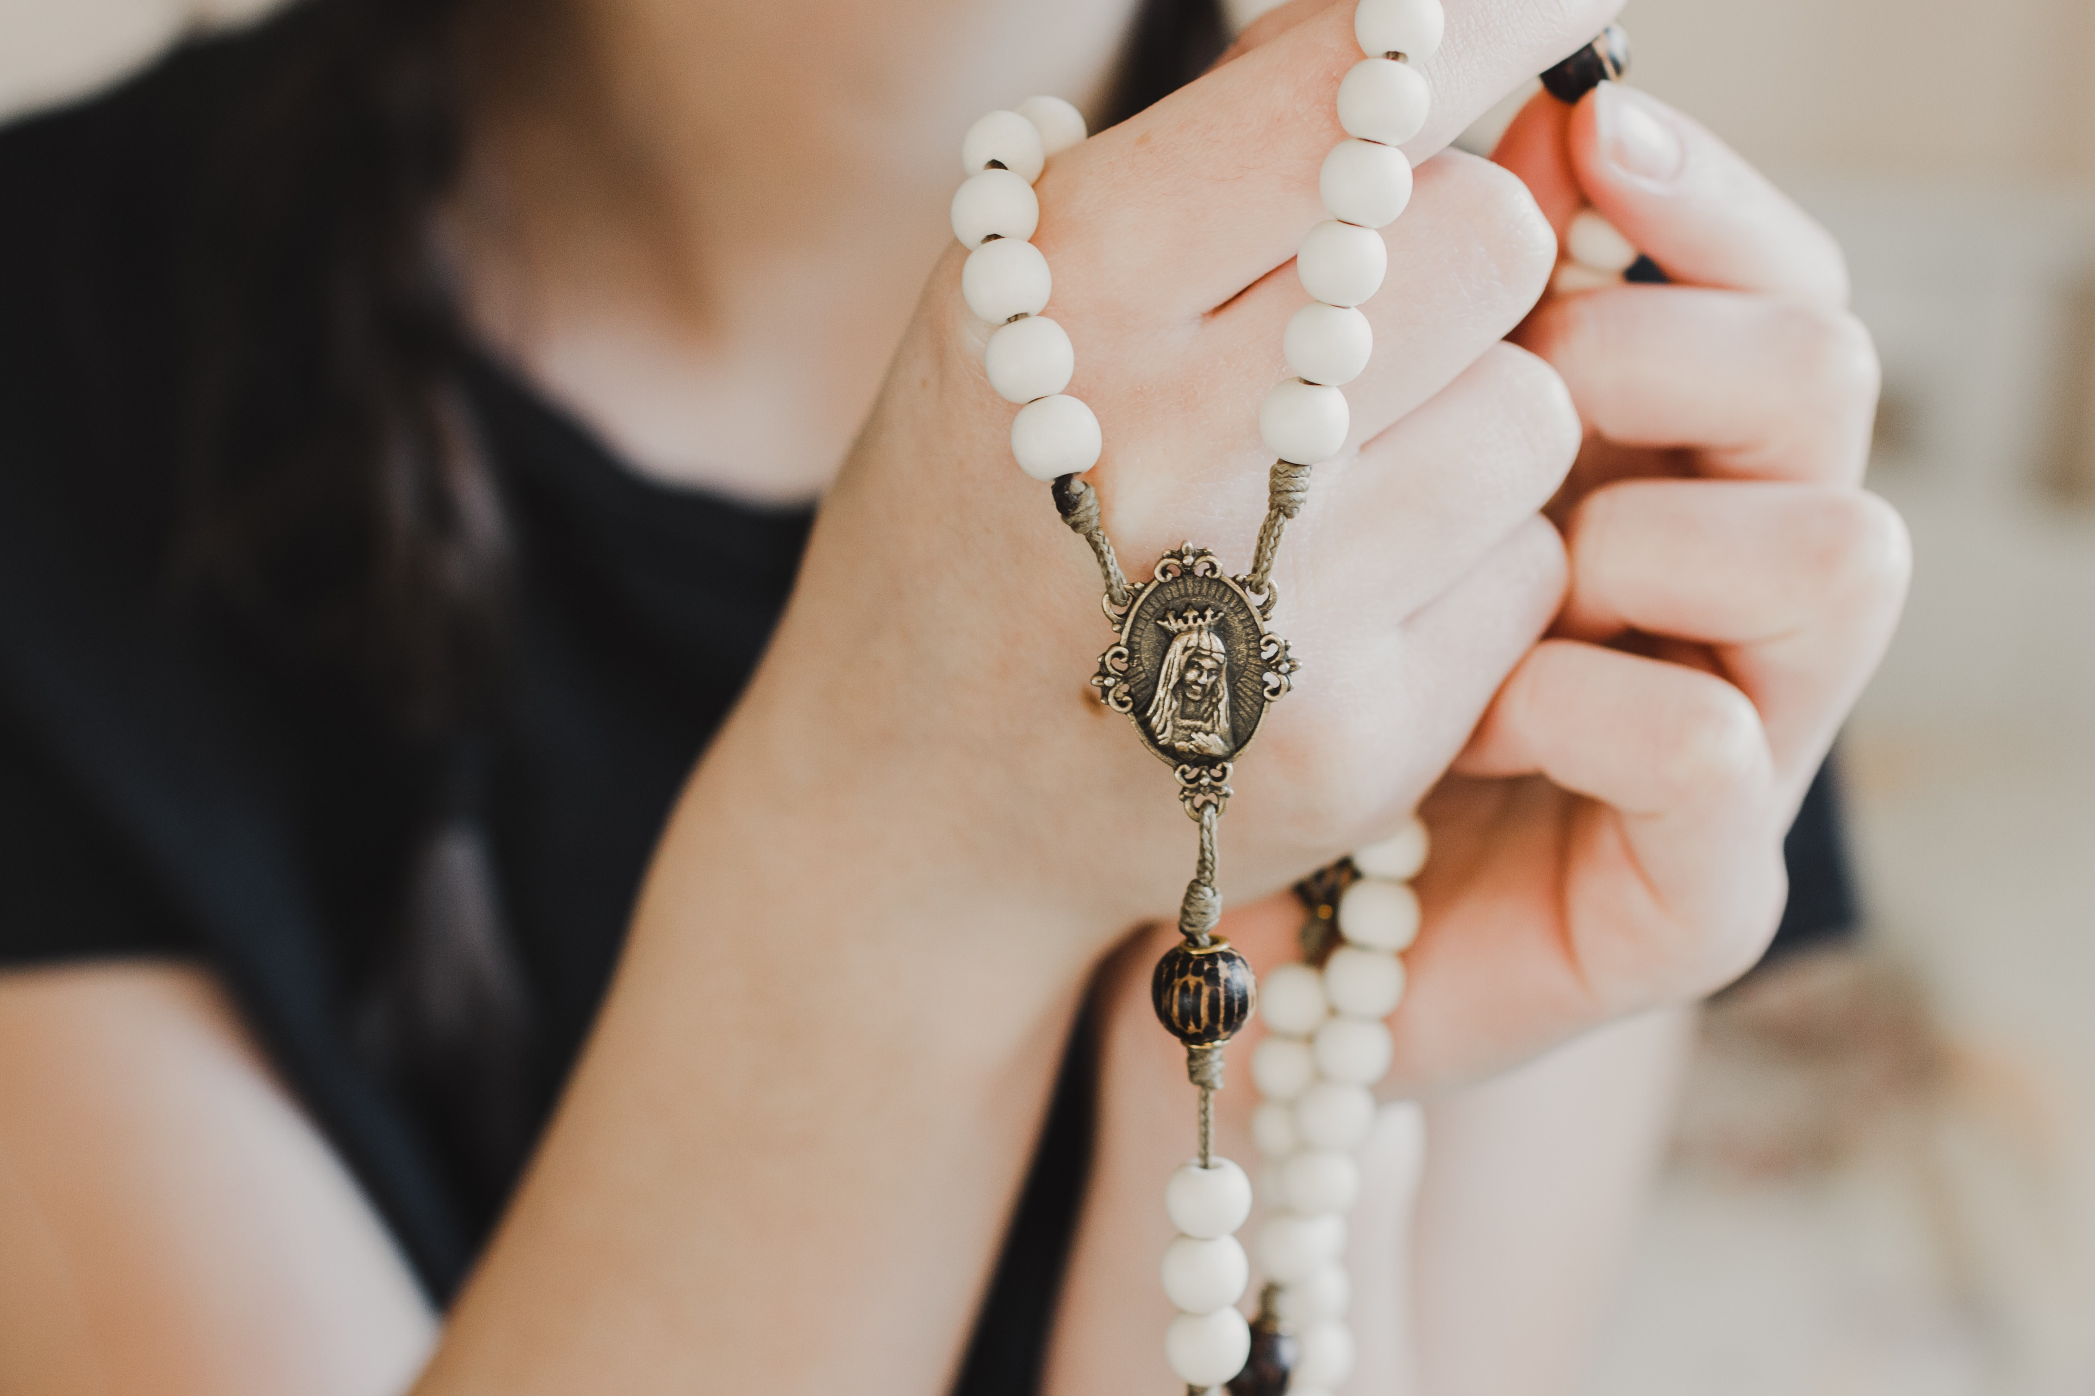
To Jesus Through Mary
Eucharistic Rosary Congress
[October 6 - 14, 2023]
Eucharistic Adoration
(provide details here about Eucharistic Adoration at your congress)
Holy Rosary – Every hour on the hour
Pray the rosary at the beginning of your hour
Confession Times (If Applicable)
Our Lady Queen of Martyrs
Catholic Church
Date/Time Range:
October 9 8am Mass –
October 10 8AM Mass
833 Magellan Dr.
Sarasota, FL 34243
Sign Up for an Hour:
or just show up!
Provide information on how to sign up here, such as a website or phone number

